Slide 1
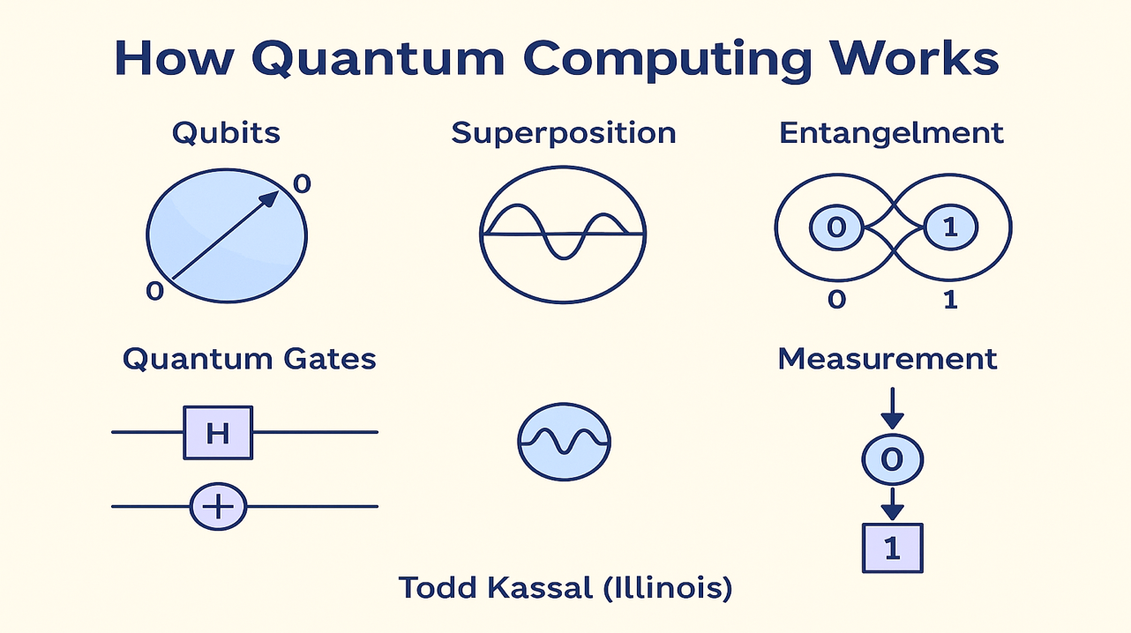




True Randomness Testing & Random Number Generators
NIST SP 800-22, Dieharder A Comprehensive Overview of RNG Testing and Quantum Approaches

Slide 2
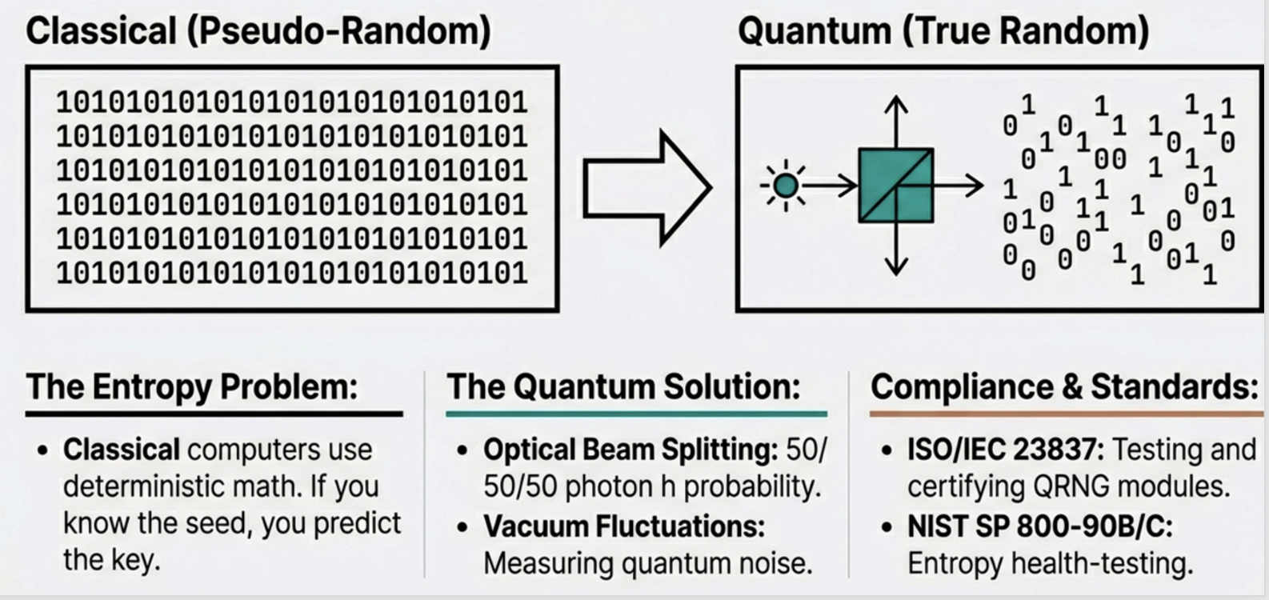
The Fundamental Problem
Unpredictability (deterministic - Pseudorandom) is about our lack of knowledge, while
True Randomness (non-deterministic) is about a lack of a deterministic pattern (in nature)
Proving Randomness
Unpredictable ≠ Random
Distinguishing true randomness from unpredictability remains a fundamental challenge in computational systems and cryptography
An event can be unpredictable due to insufficient data (entropy), but not necessarily truly random

Slide 3

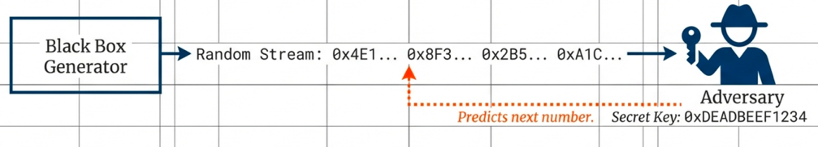
Types of Random Number Generators
True RNGs (truly random)
Pseudorandom RNGs (unpredictable)
Non-deterministic physical sources
Deterministic mathematical algorithms
Thermal noise, user input timing
Require random seed as input
Quantum effects and processes
Generate pseudorandom sequence
Distillation process for quality
Seed must come from RNG outputs
Must satisfy strict statistical criteria
Efficient for large quantities

Slide 4

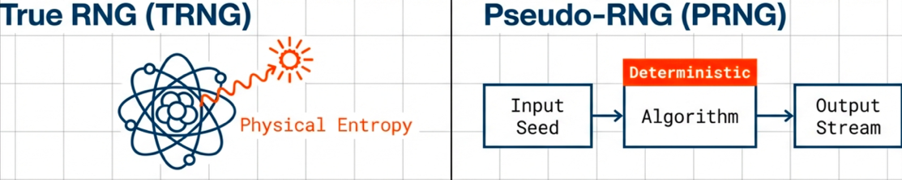
Importance of Random Numbers
Monte Carlo Simulations
Cryptography
Sampling large phase spaces for complex system modeling
Fundamental basis of Internet commerce
Mathematics & Statistics
Games
Theoretical foundations and applied contexts
Ensuring unique and unbiased user experiences

Slide 5
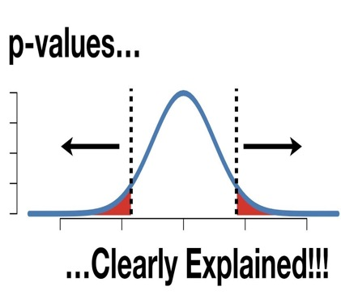
Statistical Testing Core Concepts
Purpose of Testing
Systematic test suite for all types of RNGs
Detect deviations from truly random sequences
Identify patterns or biases in binary sequences
Very Basic Test
One of the best ways to measure how random a file is involves trying to compress it.
Test Framework
"Falsely accepting a sequence as good when the generator was actually bad."
Rigorous, systematic testing methodology
— NIST SP 800-22

Slide 6

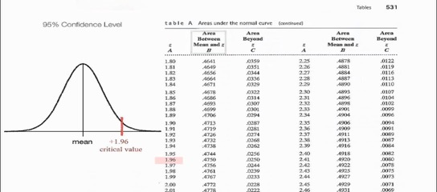
The Null Hypothesis & P-values
P-value Distribution
Null Hypothesis (H₀)
For good RNGs, P-values should be uniformly distributed across [0, 1)
The sequence being tested is random
Very Low P-value
< 10⁻⁶ → Reject H₀ (Bad generator)
High P-value
> 0.01 → Insufficient evidence to reject, but cannot prove H₀
Kolmogorov-Smirnov Test
"The null hypothesis can never be proven to be true, it can only fail to be observed to fail."
Evaluates uniformity of P-value distributions to determine probability of observing them in random sampling
— DieHarder

Slide 7

Key Test Suites - NIST SP 800-22
Purpose
Extend Diehard's methodology • Focus on bit-level randomness for cryptographic applications
Current Status
15 Tests
"Clearly Obsolete, Possibly Harmful"
• Frequency (Monobit)
• Runs Test
No longer used by NIST's DRBG validation
• Binary Matrix Rank
• DFT Transform
Weak PRNGs can pass, creating false confidence
• Universal Statistical
• Linear Complexity
• Serial Test
• Approximate Entropy
Purely statistical, not cryptographic security
• Cumulative Sums
• Random Excursions
Design Principles
Key Criticism
Unpredictability — Essential for crypto
FIPS 140-3 requires more robust SP 800-90A and SP 800-90B standards
Scalability — Tests apply to subsequences
Consistency — Across seeds

Slide 8

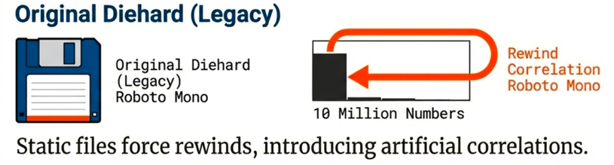
Key Test Suites - Diehard
Strengths
Weaknesses (Addressed by Dieharder)
Strong reputation for testing subtle non-randomness
Limited tests for bit-level randomness
From bit-sequence to uniform deviate distributions
Lack of parametric variability
Many tests lacked concluding KS test
Developed by George Marsaglia
Partially overlapping sequences (not truly independent)
Ambiguous licensing

Slide 9
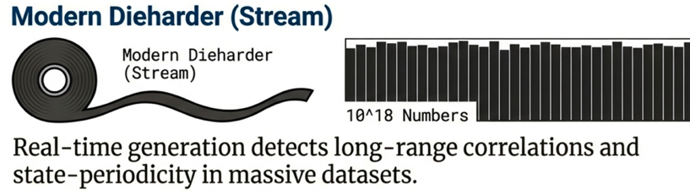
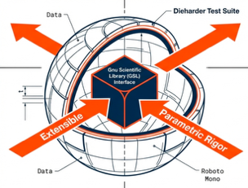
Key Test Suites - Dieharder
Key Features & Improvements
KS Test for All Tests
Adjustable Parameters
Motivation
Single P-value from KS test
Parametric exploration
Visual Histograms
Modular Structure
Address weaknesses of Diehard
P-value distributions
Easy to create/maintain tests
Extend RNG testing capabilities
Rewritten Code
GSL Integration
Provide comprehensive test framework
Well-commented C code
Gnu Scientific Library
Long Sequence Testing
Extensibility
Up to 10¹⁸ numbers
Incorporate all test suites
Timing Harness
Measure RNG speed

Slide 10

Modern Perspectives & Critiques
Critiques of Traditional Black-Box Testing (SP 800-22)
Outdated Foundation
False Confidence
Predates modern cryptography and information theory
Weak generators can pass, creating false confidence in insecure systems
Limited Focus
Incomplete Security
Focuses on statistical properties, not cryptographic security
Inadequate addressing of physical/interface security and backdoors
Missing Security Context
Modern Requirements Go Beyond Statistical Testing
Fails to consider computational hardness of breaking generators

Slide 11


Modern Security Requirements for Cryptographic RNGs
Evaluation Framework
Resistance to Attacks
Pseudorandom Generator Evaluation
Mathematical proofs linking DRBG to AES/SHA
Computational Indistinguishability
Forward/Backward Secrecy
Implementation Validation
Known Answer Tests (KATs) with formal methods
Entropy Source Evaluation
Stochastic modeling for expected entropy
No Backdoors/Trapdoors
Quantum Resistance
Physical/Interface Security
Robust protection from monitoring & interference
Modern Standards: SP 800-90 Series & AIS-31

Slide 12

Testing Frameworks and Datasets
Sample Test Results (mt19937)
Birthdays
Op Perm5
Testing Tools Overview
PASSED
PASSED
Rank 32x32
Rank 6x8
Dieharder
PASSED
PASSED
Extended methodology • KS test on all P-values
Bitstream
OPSO
PASSED
PASSED
ent (Entropy Testing)
OQSO
DNA
Entropy: 7.999994 bits/byte
PASSED
PASSED
Compression: 0%
Count 1s
Parking Lot
PASSED
PASSED
Chi-square: p ≈ 92.73%
Mean: 127.5 (ideal)
2D/3D Sphere
Squeeze
π estimate: error 0.04%
Correlation: 0.0 (ideal)
PASSED
PASSED
Sums
Runs
NIST SP 800-90B
PASSED
PASSED
Entropy source assessment tools
GCD
Craps
PASSED
WEAK
All Major Tests PASSED

Slide 13
Useful Links
- Entropy Test (ent)
https://www.fourmilab.ch/random/
Usage: dd if=/dev/random count=8192 | ent
- NIST-Statistical-Test-Suite
https://csrc.nist.gov/Projects/random-bit-generation/Documentation-and-Software/Guide-to-the-Statistical-Tests
https://github.com/terrillmoore/NIST-Statistical-Test-Suite
- Dieharder - Robert G. Brown
https://webhome.phy.duke.edu/~rgb/General/dieharder.php
https://github.com/seehuhn/dieharder
Usage: dd if=/dev/random count=8192 | dieharder -a
- RANDOM.ORG offers true random numbers to anyone on the Internet
https://www.random.org/
- DIY - Build your own TRNG
http://www.reallyreallyrandom.com/index.html

